Slide 1
Exploratory Data Analysis – 1 Second Data
Surya Sridhar

Slide 2
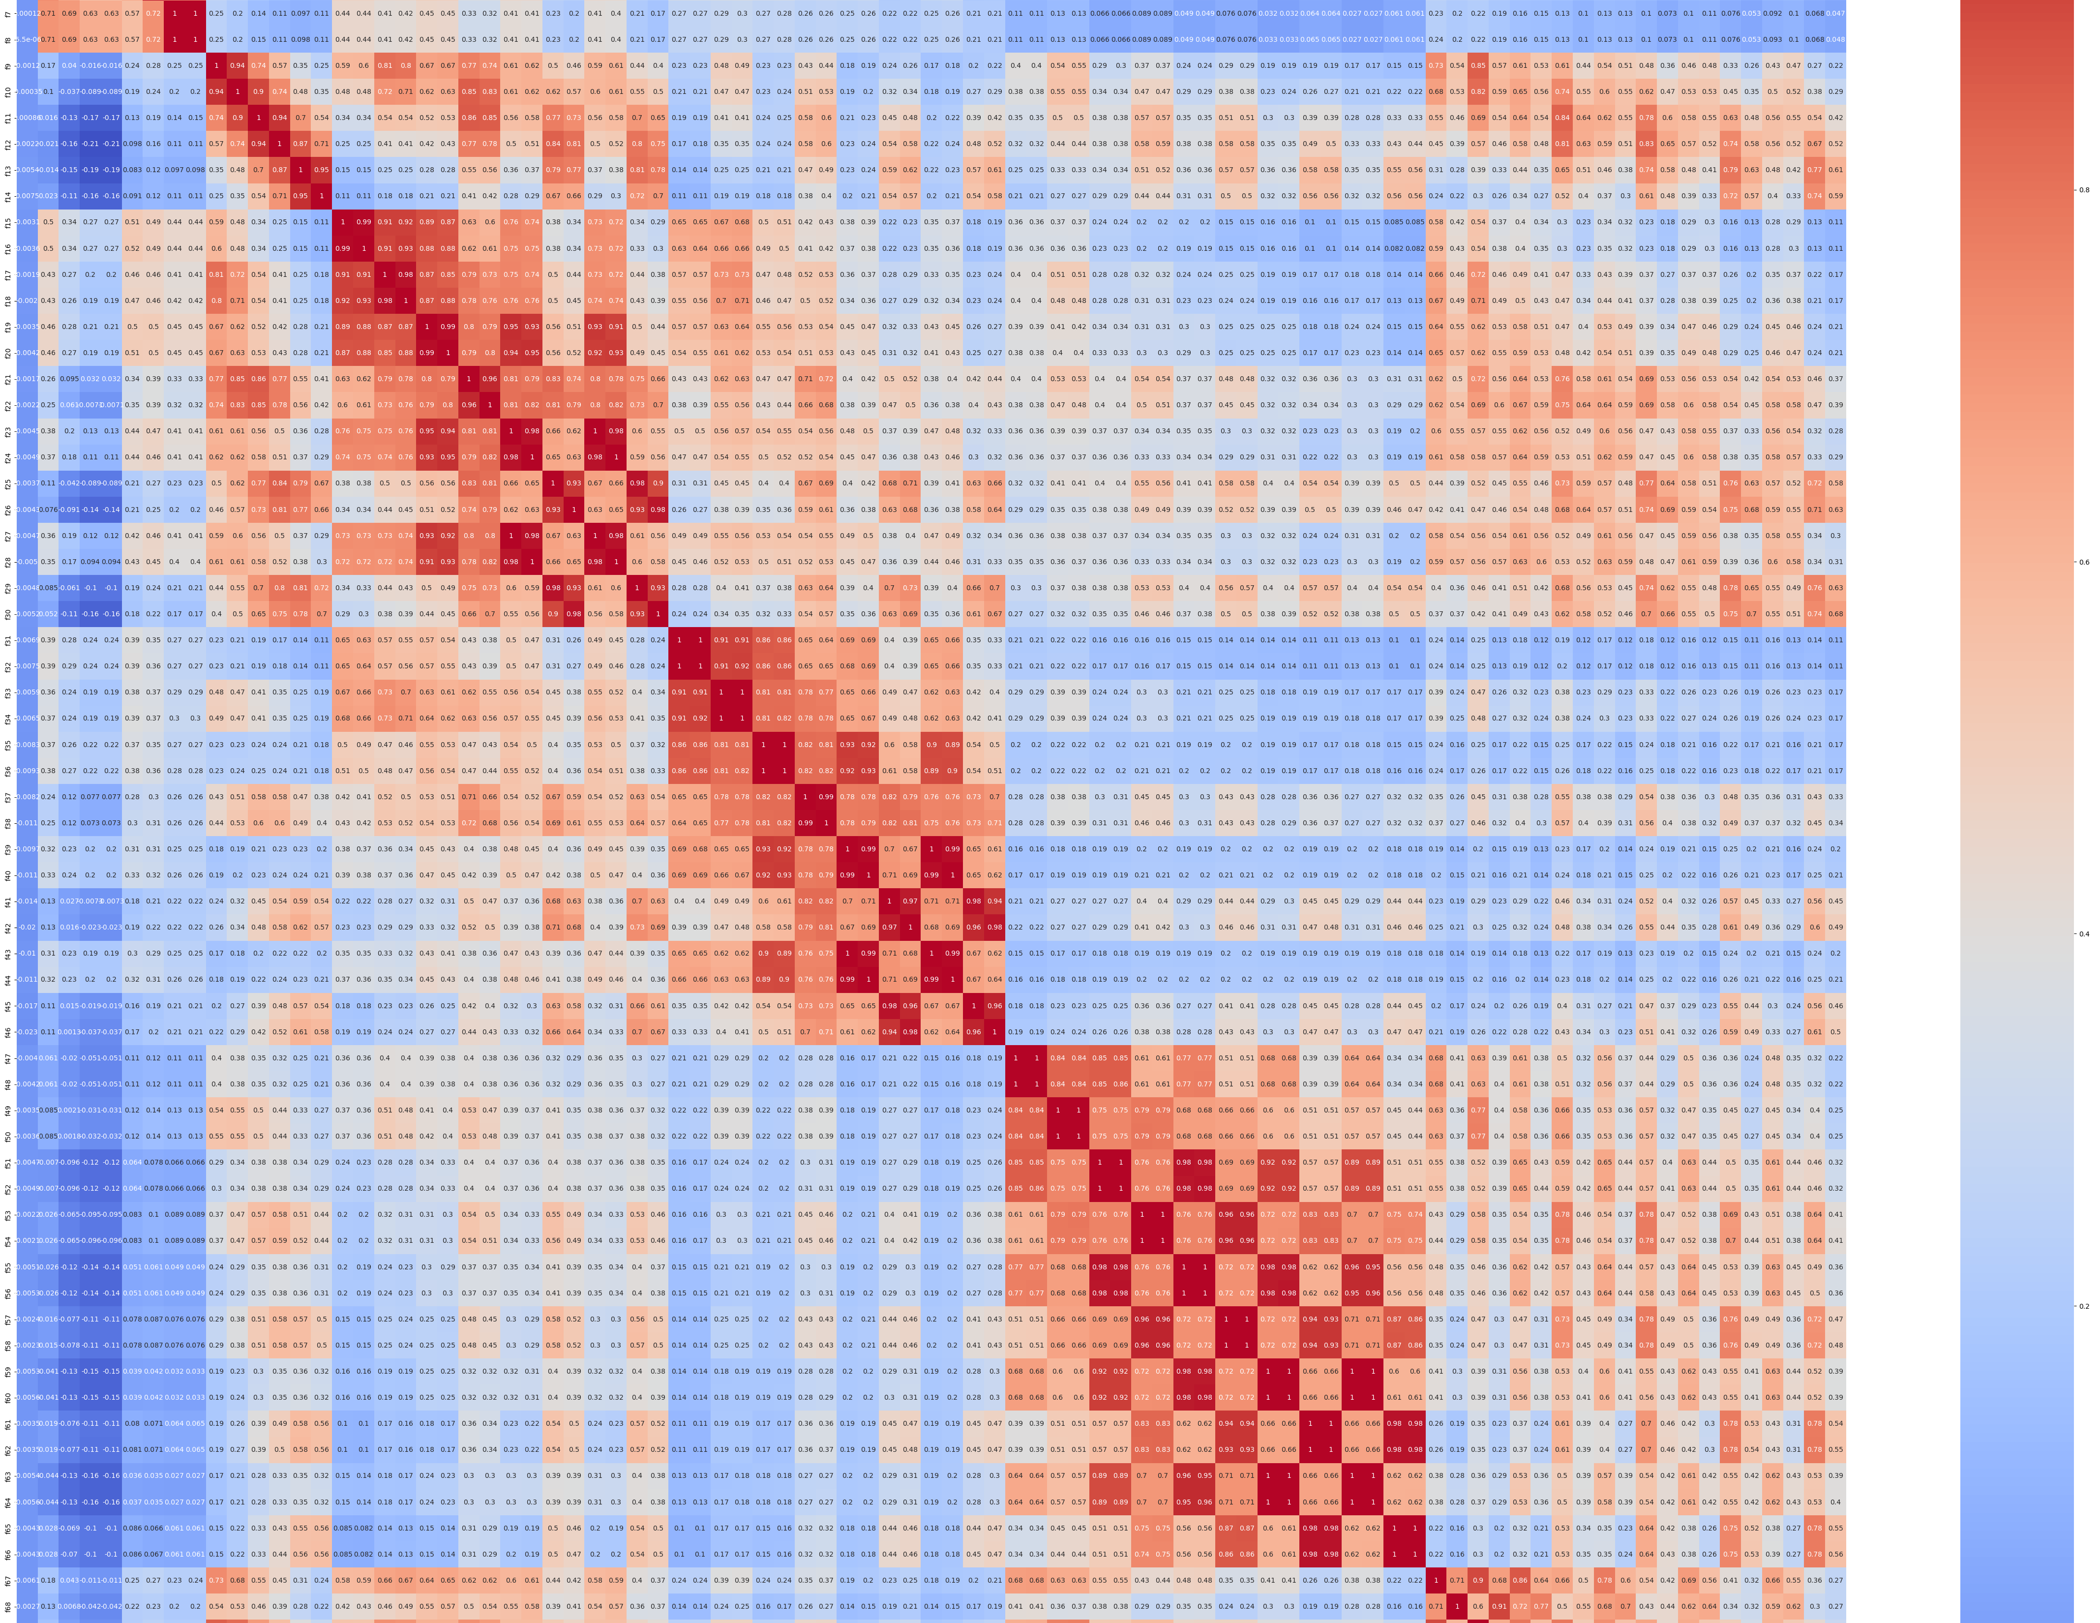
Correlation Matrix of Features
Clear repeating patterns
Is it telling the same information? If so, what?
Can we reduce dimensionality?

Slide 3
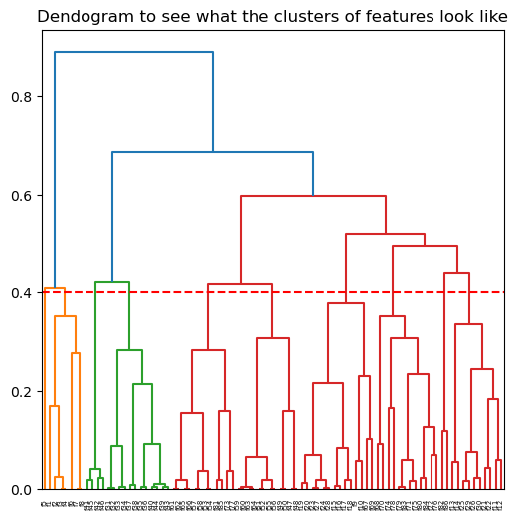
Dendograms
Arbitrary threshold based on jump height to see what groups could be formed.
Semi-matched the pattern, but not 100%

Slide 4
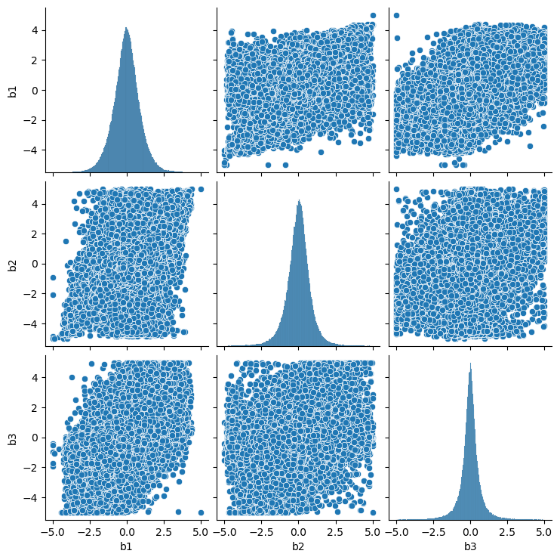
PCA + Scatterplot
Tried doing PCA on all 3 blocks (block 3 has 4 removed features)
Scatterplotted them, 1-2 have a rhombus (variance but monotonic?)

Slide 5
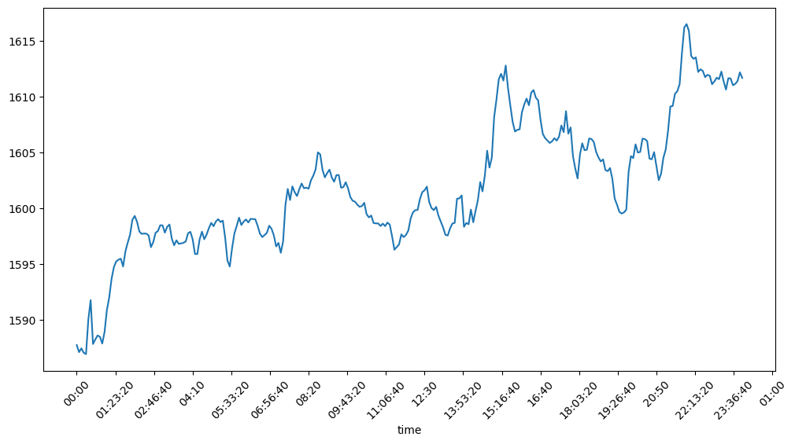
Seasonality
Attempted a EDA classic – seasonality
Tried to see if mean-grouping gave any idea on how stock behaves through the day
Noticed a discrepancy

Slide 6
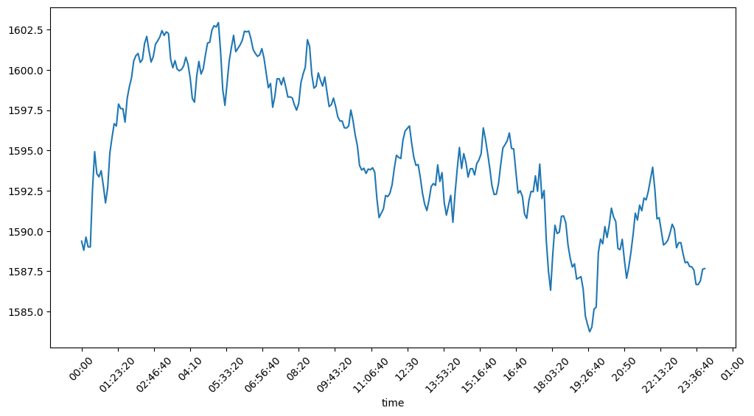
Seasonality – 2
Same seasonality, just removing last day data
It’s literally a different story
Last day is an anomaly

Slide 7
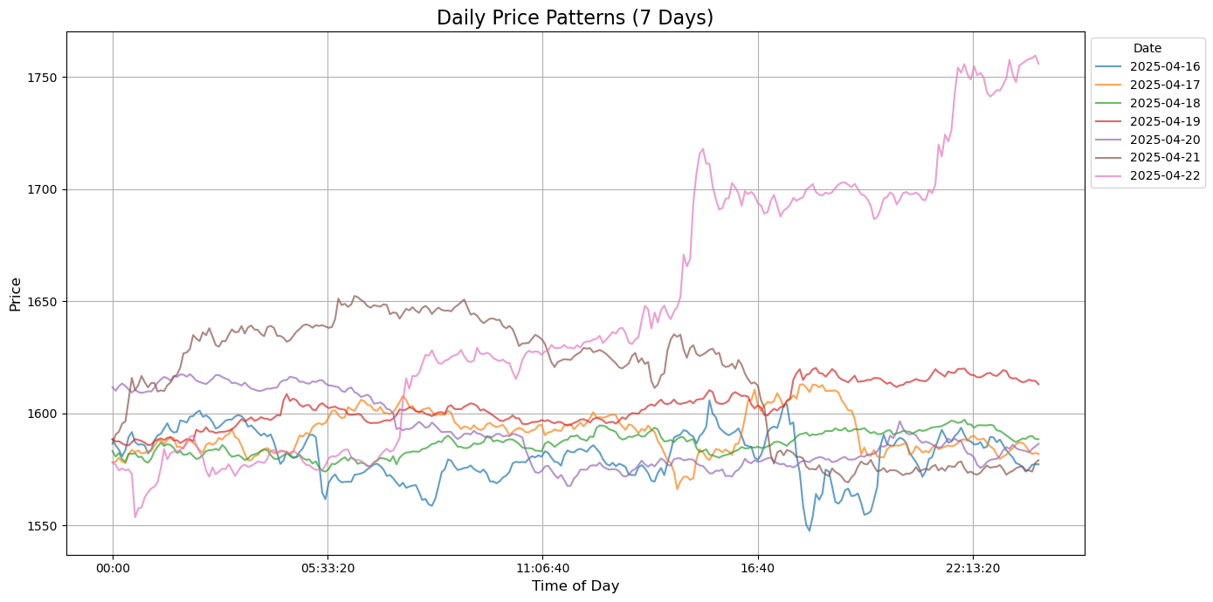
Exploring the last day – There’s 3 spikes (before market open, right before market close, and around 9pm)

Slide 8
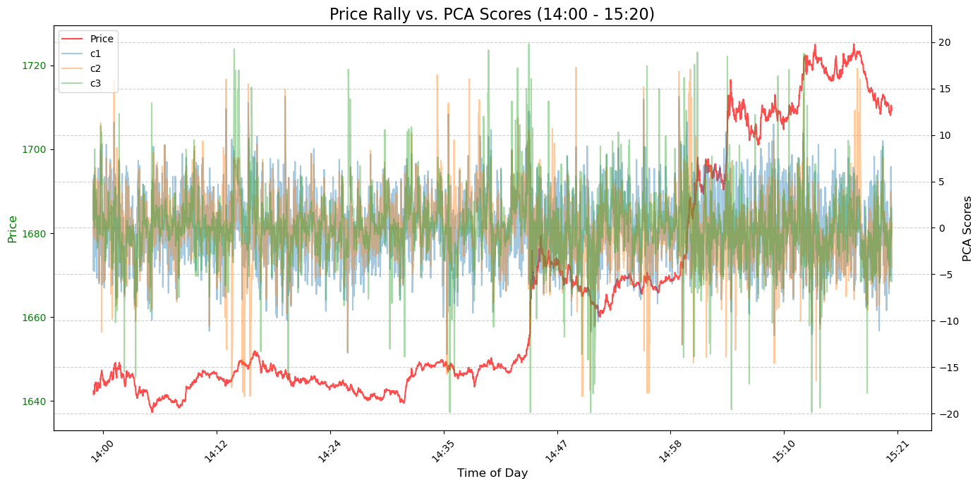
Attempt at finding something between blocks and the spike

Slide 9
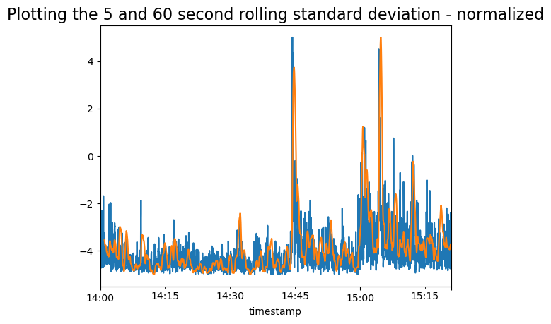
Plotted the [-5,5] for Volatility
Created 5 and 60 second windows to get volatility to see if momentum indicator could be told for the blocks that we had.

Slide 10
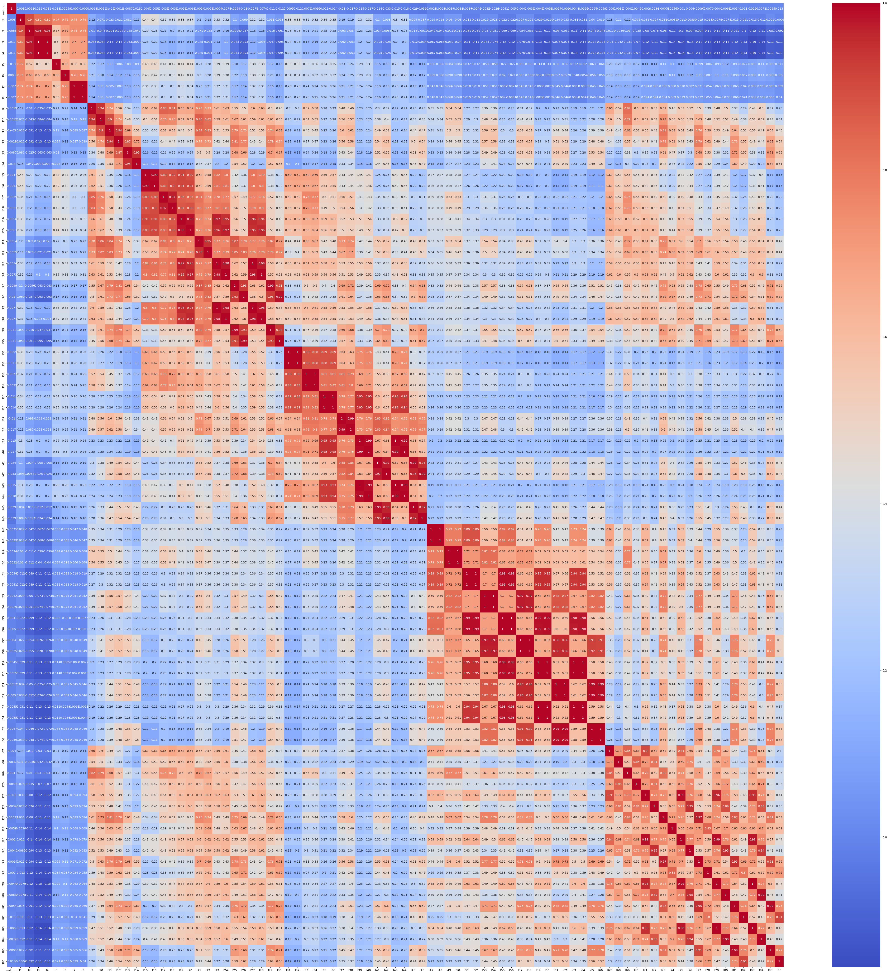
A sizeable >0.5 link!
There’s a >0.5 correlation to a different block albeit, a group of features (1 of 6), maybe that’s the volatility indicators.

Slide 11
Future Expansion
Trying to maybe see if there’s connections to other indicators that we can get.
Missing volume info makes me think maybe that’s hidden in there somewhere
The pattern in the correlation heatmap is really fascinating so that’s something I’m going to try and find more in.

